Slide 1

Argusa Challenge
October 2024
Le Hoang Sao Mai

Slide 2
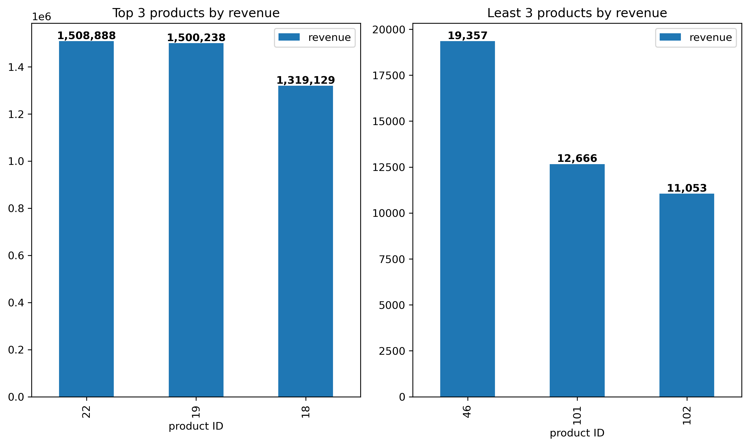
Question 1
What are the top 3 and worst 3 products in terms of revenue ? What isthe value of their revenue ? (7 points)

Slide 3
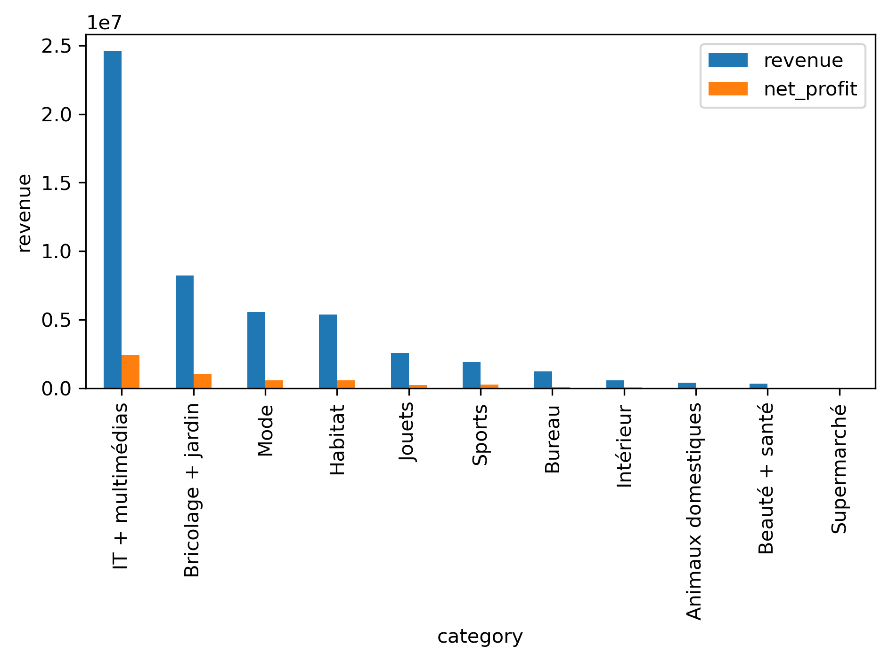

Question 2
Which category (category_1) has the highest net profit What are the net profit and revenue ? for that category? Is it also the category with the highest revenue ? (5 points)
IT + multimédias
Revenue : 24568238.36 CHF
Net profit : 2414656.910 CHF

Slide 4

Question 3
Within the category with the highest net profit * which product generates the highest net profit ? And the lowest? What is the value of its net profit ? (4 points)
HP ProBook 450 G9
Net profit : 168718 CHF
SanDisk Extreme PRO microSDXC, 64 Gb
Net profit : 758.2 CHF

Slide 5
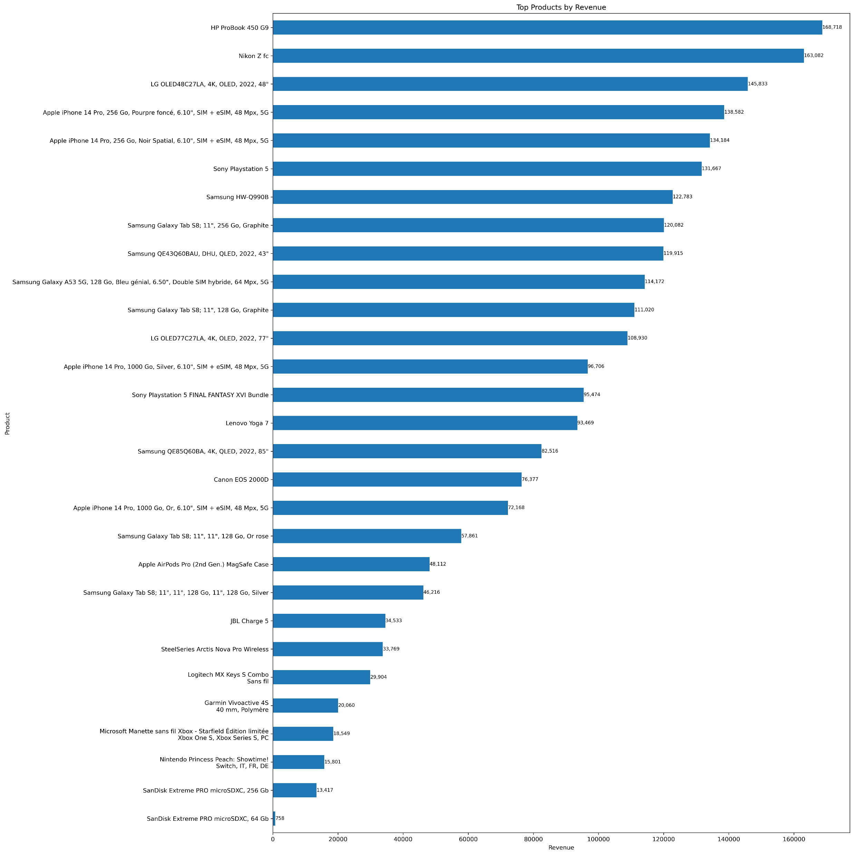

Slide 6
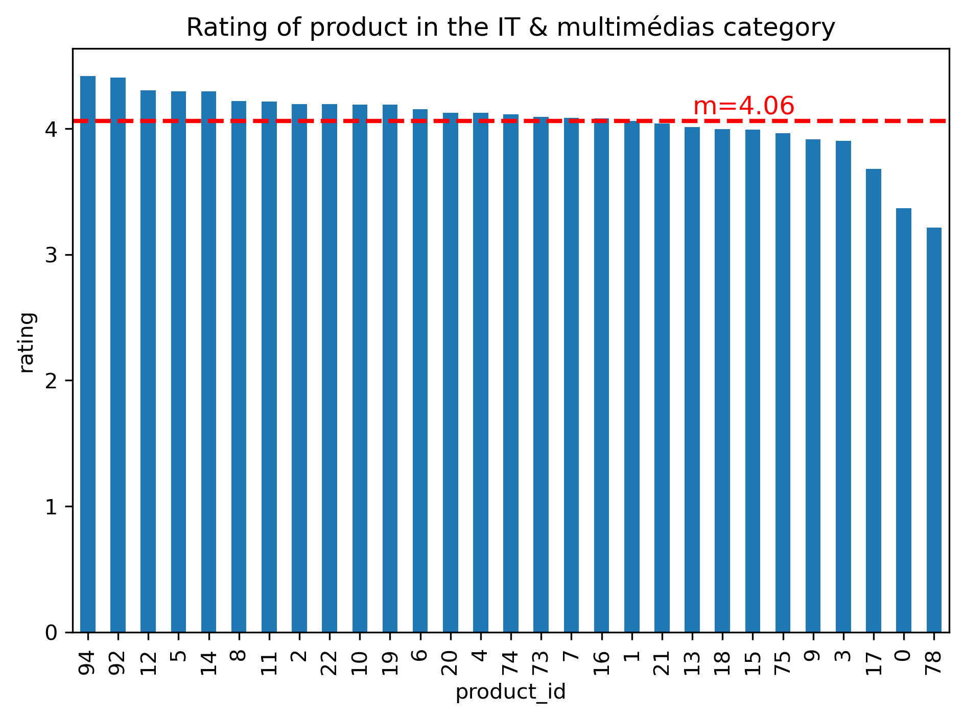
Question 4
Within the same category*, calculate the average rating of each product. What is the average of these averages (call it m)? Which product’s average differs the most from m? (5 points)
Product ID 78 differs the most from the average of these average

Slide 7

Question 5
What are the first and last name of the best client by net profit ? How much net profit did he/she generate and how many orders did he/she make? What are the first and last name of the best client by number of orders? How much net profit did he/she generate and how many orders did he/she make? (6 points)
Best by net profit
Camille Bouvier
Net profit: 3412.409 CHF
Nbr order: 35
Best by order
Théo Martin
Net profit:2335.778CHF
Nbr order: 45

Slide 8
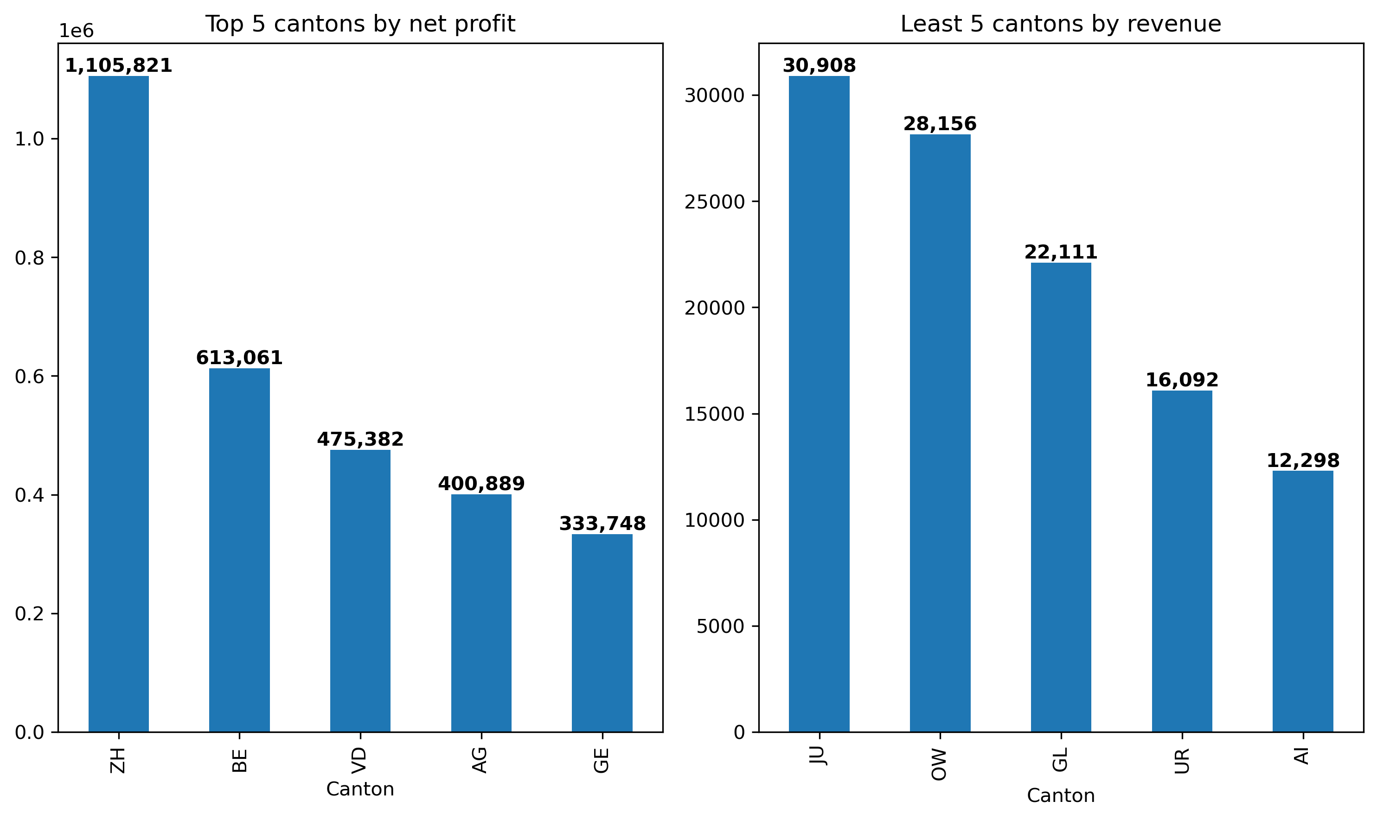
Question 6
Which are the top 5/bottom5 cantons by net profit ?

Slide 9
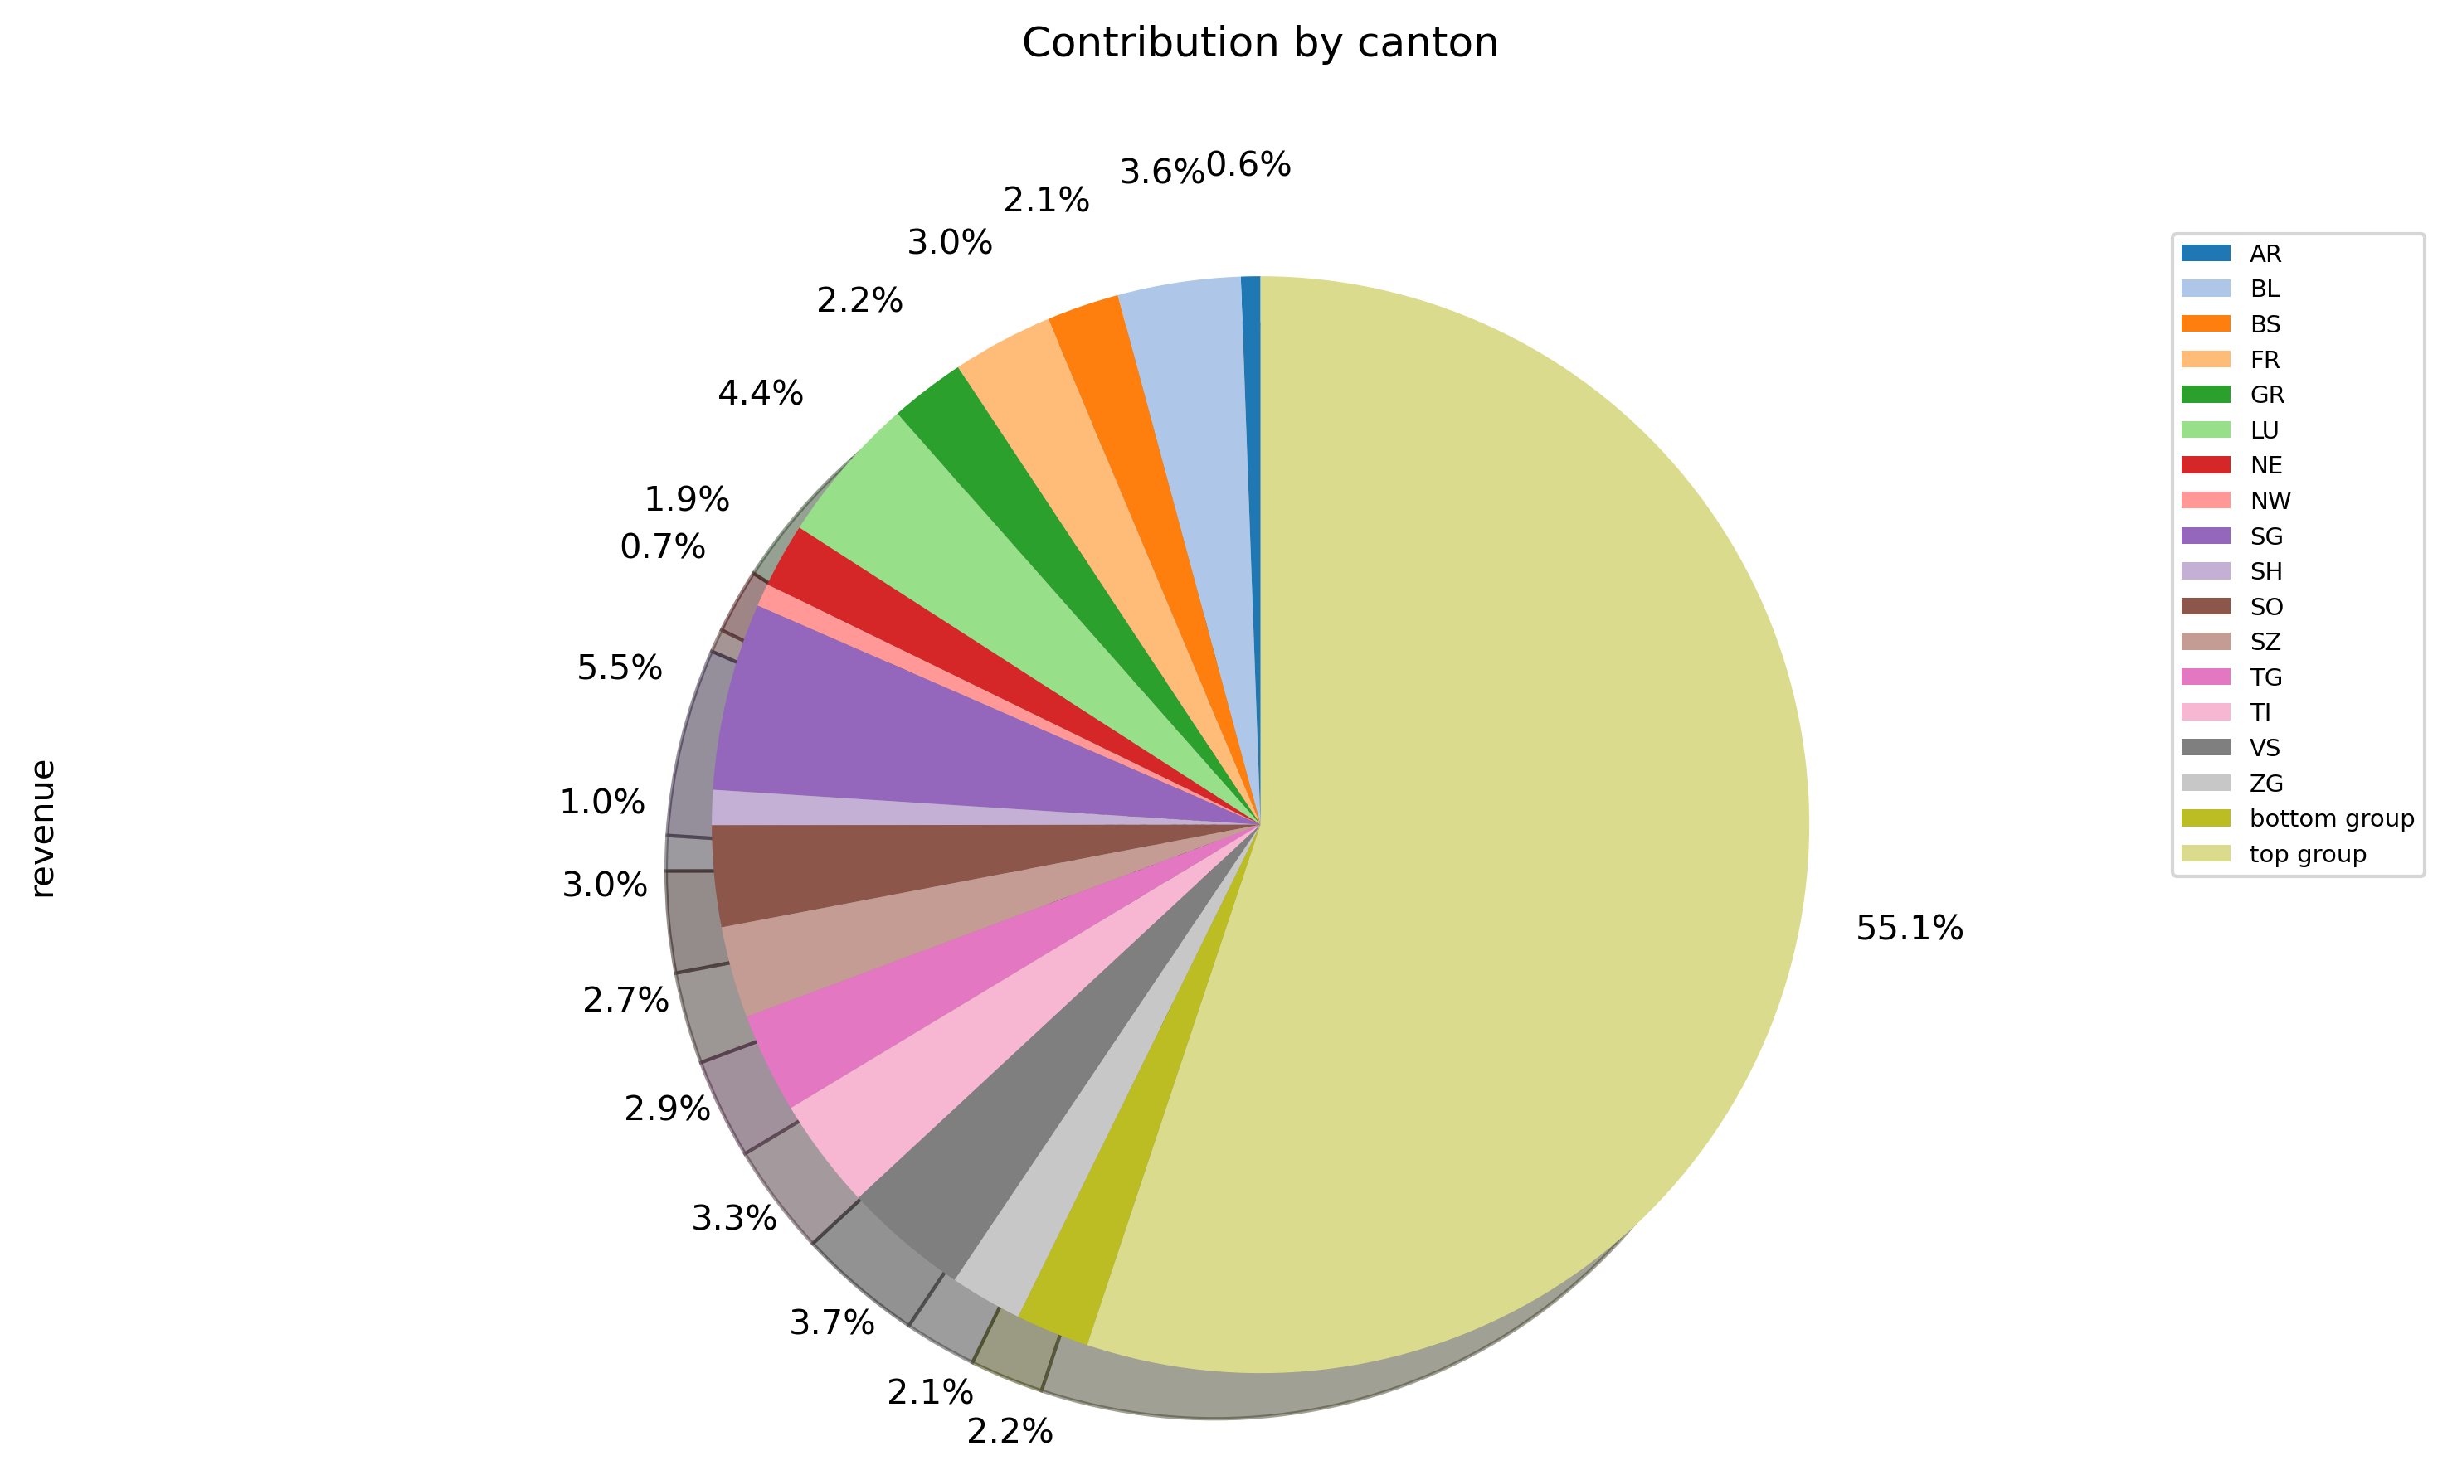
What fraction of the total net profit is brought by the top group, and by the bottom group? (5 points)

Slide 10
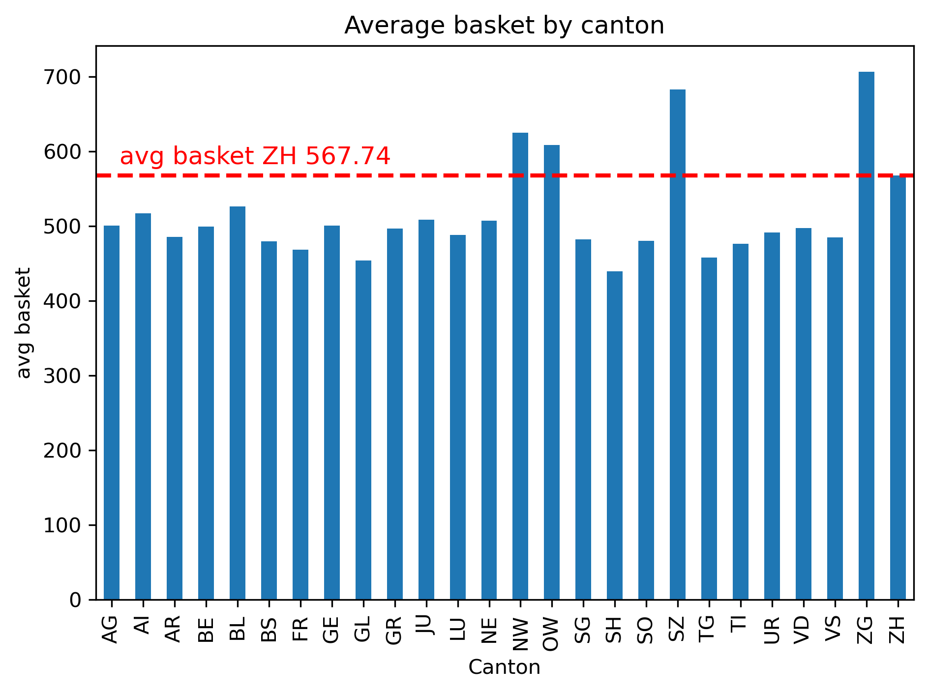
Question 7
Which is the canton with the highest net profit In which cantons is the average ? basket higher than in that canton? (5 points)
Canton highest net profit : ZH
Canton with higher average basket: NW, OW, SZ, ZG

